Slide 1

Cloud Based Web Application for Real-Time Flight Information
GROUP 4
KRYSH RENDRAN LAUREN MEYER MICHAEL FORNITO JUNGWON ZANG THOMAS FEILLO
GROUP 4
Jungwon Zang, Krysh Rajendran, Lauren Meyer, Mike Fornito, Thomas Fiello

Slide 2


Introduction
There are an average of 150,000 flights a day, including commercial planes, small planes, private jets, and helicopters.
Since 2020, all civil aircrafts have been required to broadcast a signal, called ADS-B, during every second of flight.
The goal of this project is the analysis and delivery of accurate, real-time information through ADS-B Out.
This signal contains all pertinent identification and flight information, which is continuously monitored by ground stations.

Slide 3





Literature Review
Search & Choose
Thesis
Select a Topic
Development of Automated Flight Data Collection System for Air Transportation, 2016
Improved Information Retrieval Performance on SQL Database Using Data Adapter Statistics, 2018
Comparison between RDBMS and NoSQL for Aviation Data, 2019
An integration approach of hybrid databases based on SQL in cloud computing environment, 2018
Cloud Computing
Flight Data Collection
Web Application
Database Design

Slide 4

Literature Review
Analyze & Review the Thesis
Topic: Real-time data collection
Website Scraping Method for monitoring and tracking flight
Using Python programming language and API provided by the website
Topic: Database design(2/21 assignment)
NoSQL to deal with JSON data format
Integration approach of relational database and non-relational database
Hybrid Database Design
From
Development of Automated Flight Data Collection System for Air Transportation, 2016
Improved Information Retrieval Performance on SQL Database Using Data Adapter Statistics, 2018
From
Comparison between RDBMS and NoSQL for Aviation Data, 2019
An integration approach of hybrid databases based on SQL in cloud computing environment, 2018

Slide 5

Literature Review
Our project approach after literature review
Using OpenSky API for real-time flight data
Flask Python/Javascript for programming language
Using Google Cloud SQL Database System for data analysis and storing
Using Website hosting for sharing extracted and analyzed flight data

Slide 6
Goal Of the Project
Track airlines using ADS-B to and from, as well as around the Daytona Beach International Airport
We hope to:
Create an efficient space for local travelers/commuters to follow along with their hometown airport traffic
Create a space for travelers to interactive with real-time flight data
Help travelers and airlines with travel planning
Draw attention to any anomalies that may take place upon landing or take off

Slide 7

Why Flight Data
The introduction of ADS-B is a major improvement over classical radar systems and paves the way for safer, more efficient air traffic management.
Unfortunately, in its current state, the system is still vulnerable to attacks such as 'spoofing'.
This project will create and maintain a cloud-based database of incoming ADS-B signals for real-time analysis, such as anomaly-detection.

Slide 8
The Data ADS-B Out
Stands for Automatic Dependent Surveillance Broadcast. Some aircraft are even equipped with ADS-B In which allows them to also receive ADS-B data from any aircraft in the vicinity.
It contains valuable information, such as: callsign, GPS location, altitude, ground speed, indicated airspeed, true airspeed, track, track rate, roll, magnetic heading, true heading, vertical rate, alert status, wind direction and velocity, outside air temperature, total air temperature, alert status and much more.
It forms the foundation for NextGen air traffic control by moving from classical ground radar and navigational aids to precise satellite tracking.
The NEXTGEN approach changes the aviation industry and allows for increased:
Core Surveillance
Cockpit Advisory Services
Cockpit Critical Services

Slide 9


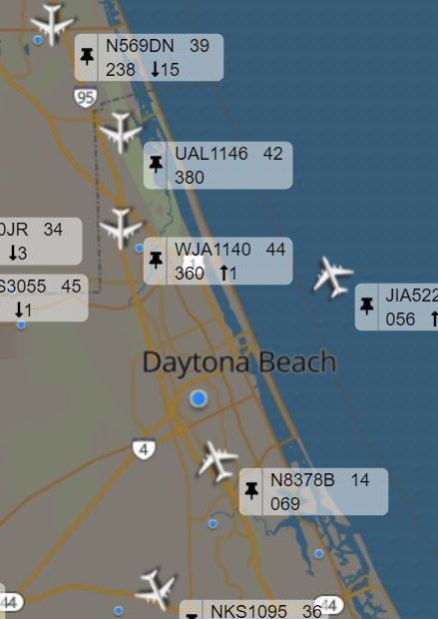
The API
Our project uses real-time flight data gathered through an API provided by The OpenSky Network.
The OpenSky network is built from the collaboration of hobbyists and professionals around the world, all collecting and sharing the information they collect from home-made receivers.
The collected ADS-B signals contain the identification and current state of each aircraft, such as position, vector, etc, and are stored in a repository maintained by The OpenSky Network.

Slide 10
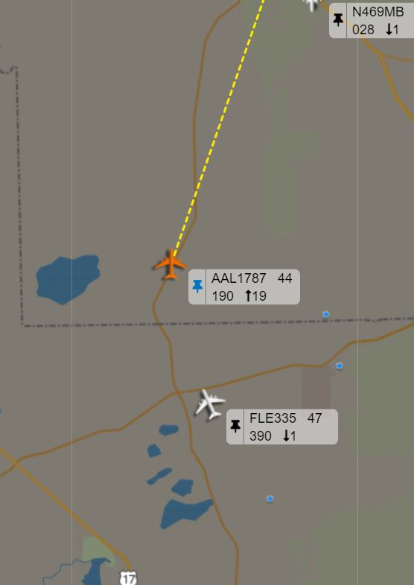
The Data to the Database
The API will populate our MySQL database with updates from the Daytona Beach International airport (KDAB).
Including:
Flight Number
Airline Name
Flight Status
Departure and Arrival Times
Abnormalities in take-off or landing

Slide 11
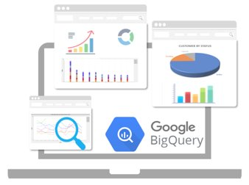
Google’s BigQuery
Cloud-based alternative to local SQL databases
Benefits:
Built-in services cut down on management/maintenance
Designed to integrate with other Google Cloud Services
Supports most popular DBM software
Scalable speed and storage size
Cons:
Expensive
A lack of experience with cloud architecture

Slide 12
The Process
Grabs ADS-B Data through the API
01
Data sent to Python to process data
02
Uploads data to big query
03
Appends new uploads so no duplicates
04
JSON code connects to the website

Slide 13

Previous Website Hosting: Inmotion hosting
Rankings/Accolades: Max Cnet Rating A+ from BBB
Hosting Benefits:
Unlimited Bandwidth
Unlimited Addon Domains
Unlimited Disk Space (NVMe SSDs)
Built-in Database Support through cPanel

Slide 14
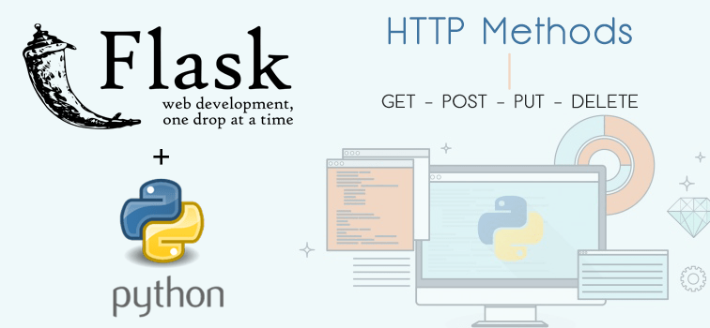
FINAL Website Hosting: GOOGLE WEB APPLICATION

Slide 15
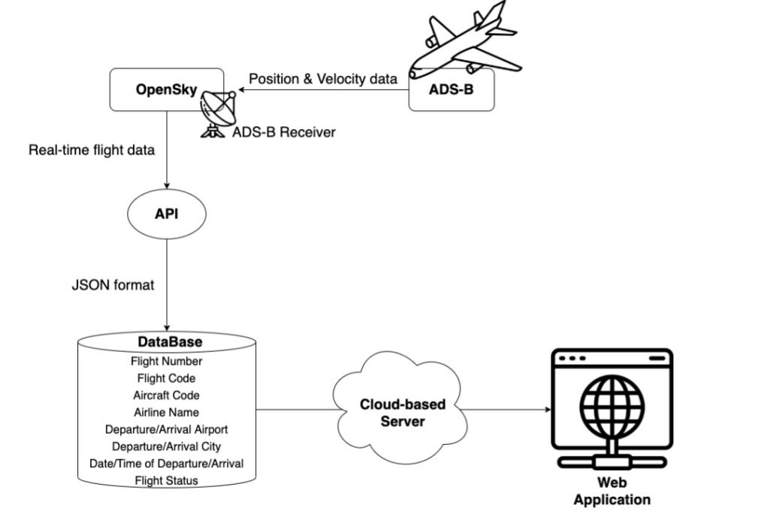
The Process: 1. System Architecture with OpenSky API

Slide 16
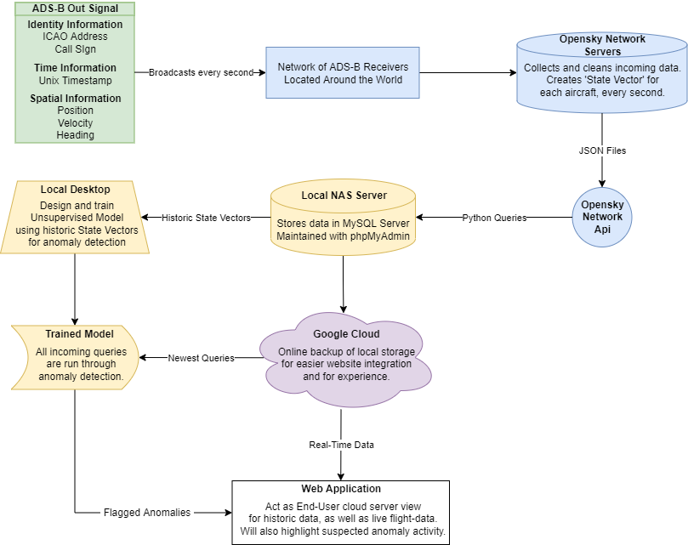
System Design Diagram
Notes:
No longer using NAS.
Only doing model if we have time

Slide 17
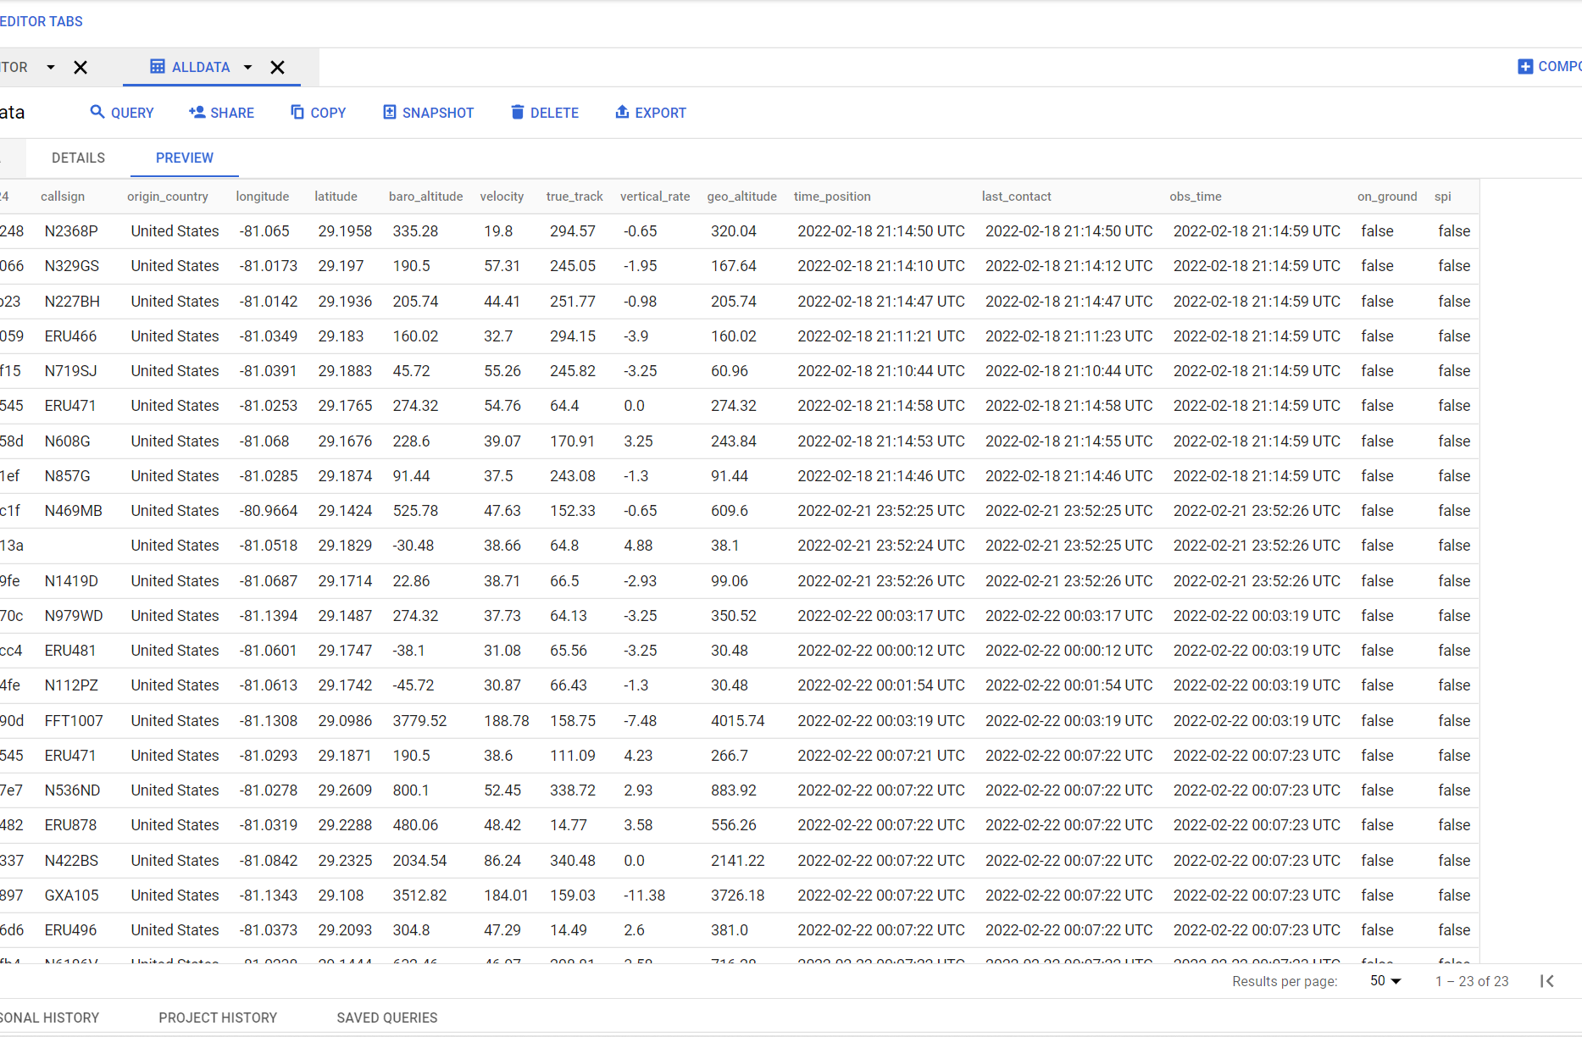
The Process: 2. Data to Python
The flight data is filtered for our project's specifications.
Items we are focused on:
Flights from or into Daytona Beach International Airport
Go Around Detection (Work in Progress)

Slide 18
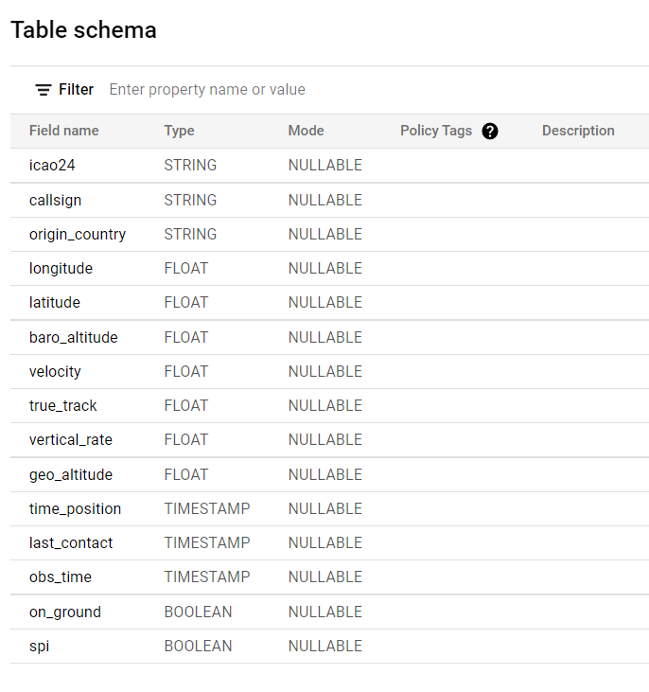
The Process: 3. Database Schema in the Cloud
icao24 - ICAO24 address of the transmitter in hex string representation.
time_position - seconds since epoch of last position report. Can be None if there was no position report received by OpenSky within 15s before.
last_contact - seconds since epoch of last received message from this transponder
longitude - in ellipsoidal coordinates (WGS-84) and degrees. Can be None
latitude - in ellipsoidal coordinates (WGS-84) and degrees. Can be None
geo_altitude - geometric altitude in meters. Can be None
on_ground - true if aircraft is on ground (sends ADS-B surface position reports).
velocity - over ground in m/s. Can be None if information not present
heading - in decimal degrees (0 is north). Can be None if information not present.

Slide 19
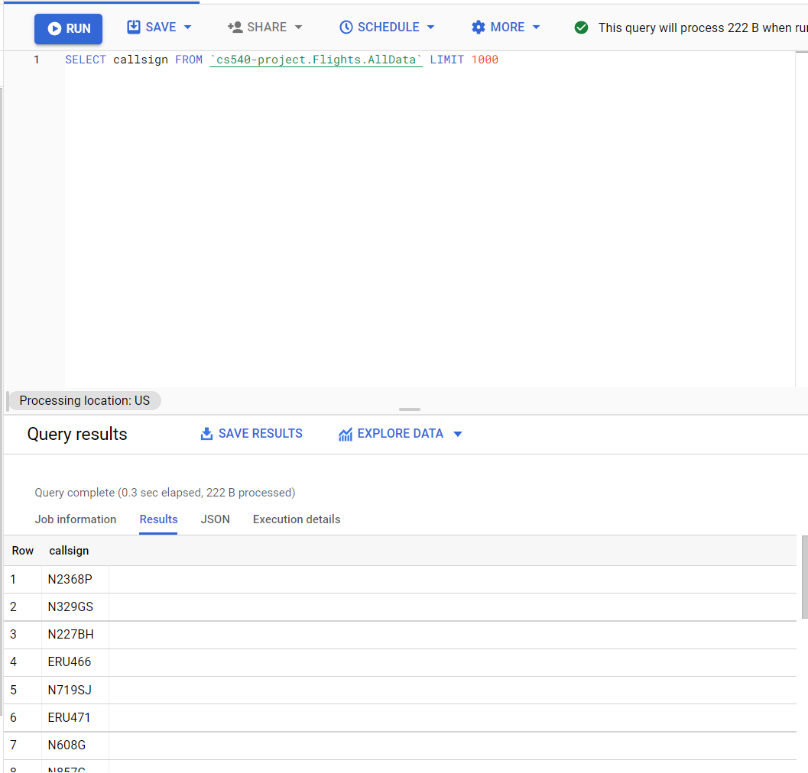
The Process: 3. Google Cloud Shell
Upon implementation of our project, we discovered that managing our database through BigQuery is a better alternative to running our queries through MySQL workbench.
Provides a cloud-based alternative to local MySQL, PostgreSQL, and SQL Server databases.

Slide 20
The Process: 4. Uploads data and prepares for visual
Queries are run in Python, and then sent to BigQuery.
For Example: "SELECT Flight_Number
FROM DATA
Where LOCATION = KDAB"

Slide 21
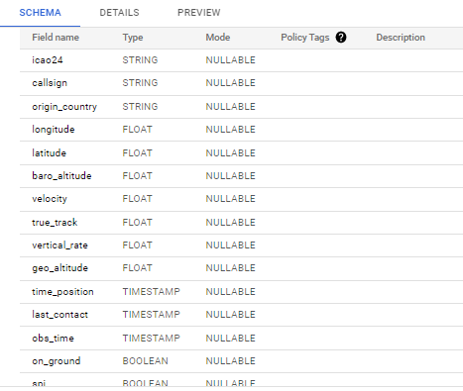
Google BigQuery
TABLE SCHEMA OF OUR DATASET

Slide 22
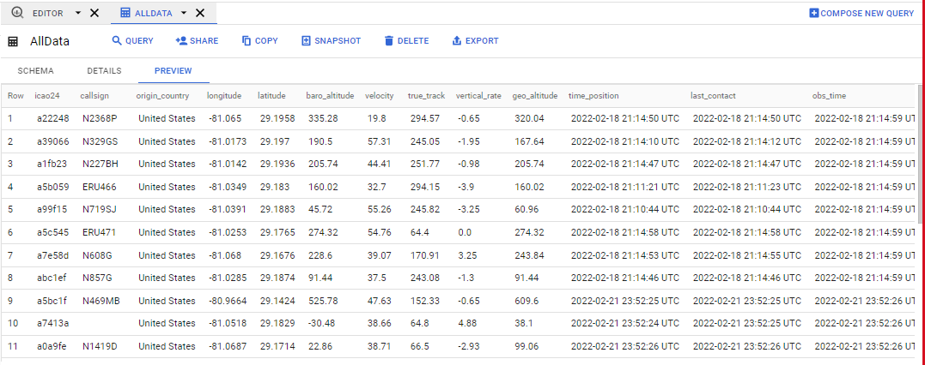
Google BigQuery
EXAMPLE OF IMPORTED "AllData" DATA IN DATASET

Slide 23
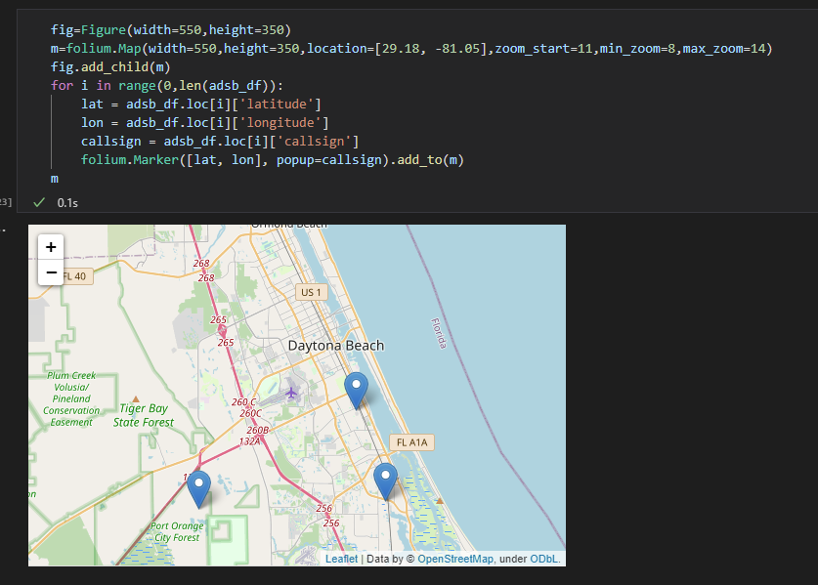
The Process: 4. Preparing the data for visualization
The data for KDAB will be run through python to create a visualization of real-time flight data.
This visualization will be pushed through JSON to the front-end view on the website.

Slide 24
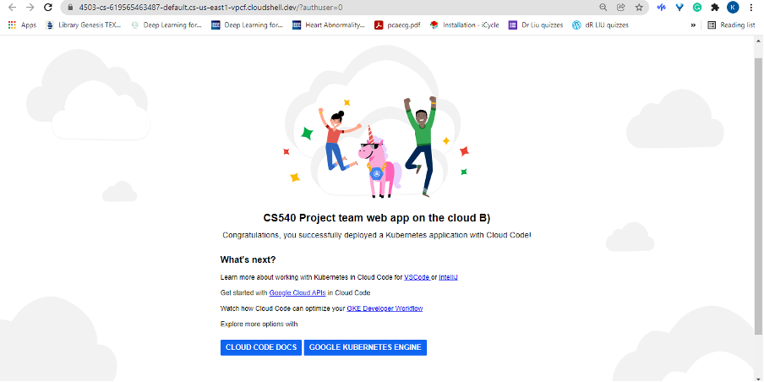
Google Cloud BigQuery Connection

Slide 25
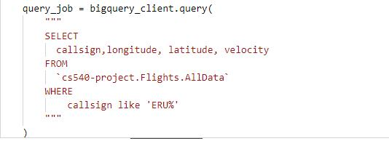
Google Cloud BigQuery Connection

Slide 26
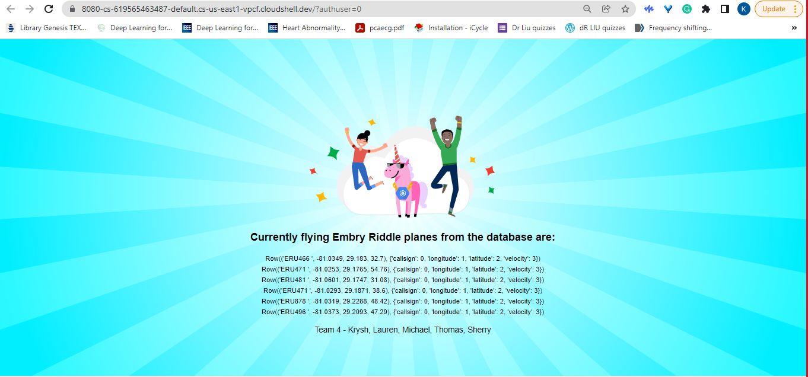
Google Cloud BigQuery Connection
OUTPUT OF BIGQUERY DATA TO WEB APPLICATION - BEFORE
텍스트를 입력하십시오

Slide 27
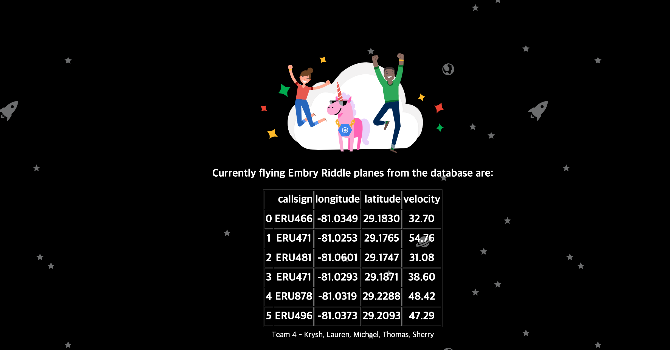
Google Cloud BigQuery Connection
OUTPUT OF BIGQUERY DATA TO WEB APPLICATION - AFTER
텍스트를 입력하십시오

Slide 28
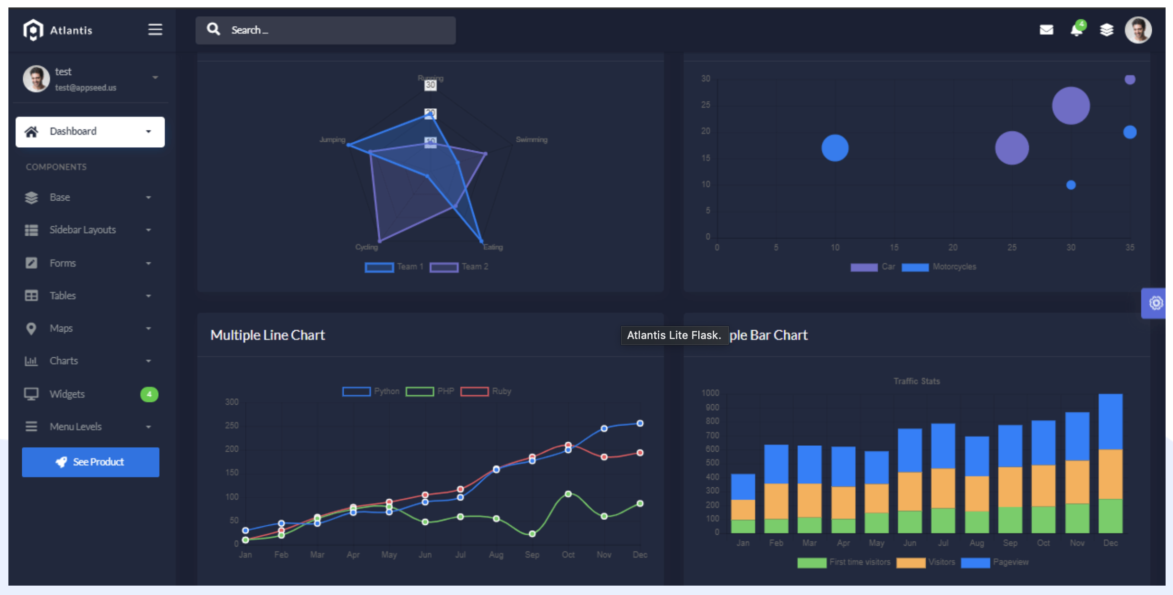
The Process: 5. JSON to website
Visualizations will be pushed from the cloud queries and python code criteria to the user on the front-end Google Web Application using a modified Flask Template designed for data analytics.

Slide 29
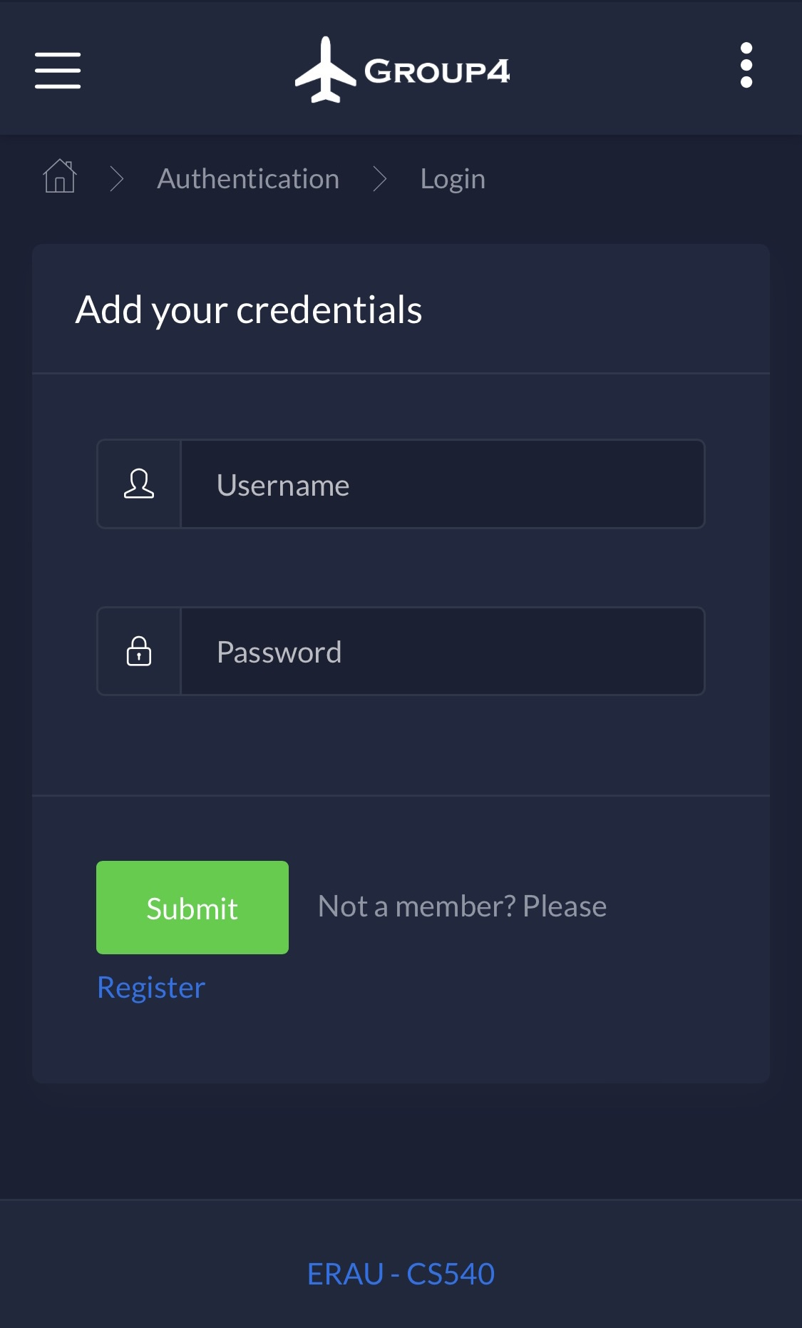
Flask Web Application
Built-in local registration and authentication via SQLAlchemy.
Already setup for mobile and desktop views.

Slide 30
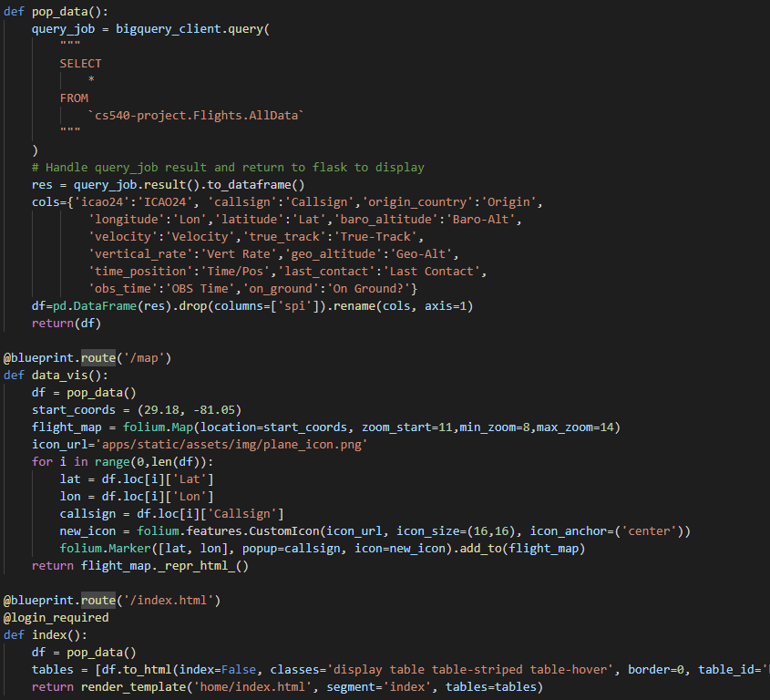
Flask database visualization
Python queries all data from BigQuery.

Slide 31
Flask database visualization
Python queries all data from BigQuery.
Formats columns to be more user-friendly.

Slide 32
Flask database visualization
Python queries all data from BigQuery.
Formats columns to be more user-friendly.
Converts table to HTML and pushes to index.html page.

Slide 33
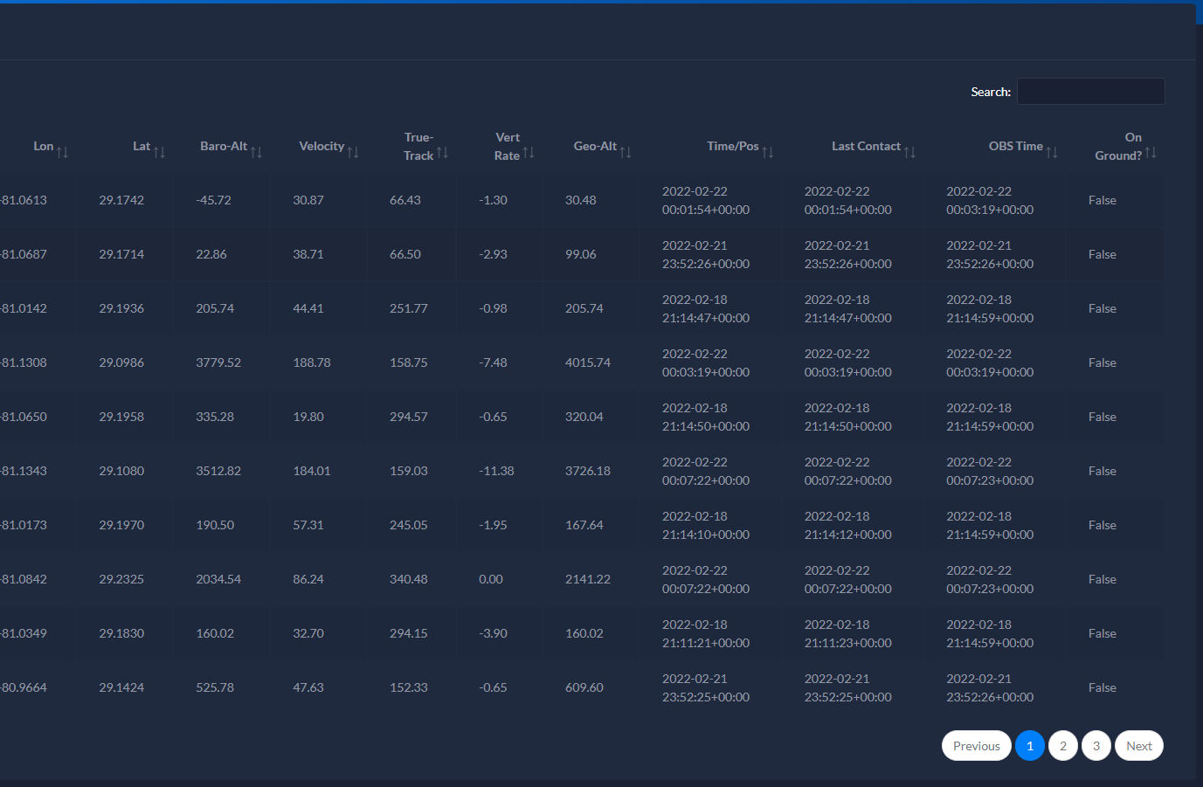
Flask Database Visualization
HTML page uses CSS and JS to present cleaned, searchable database.

Slide 34
Flask Interactive Map
Uses Folium to produce interactive maps.
Starts out centered at Daytona Beach.
Uses the queried database to place custom plane icons at their real positions.
Returns formatted HTML.

Slide 35
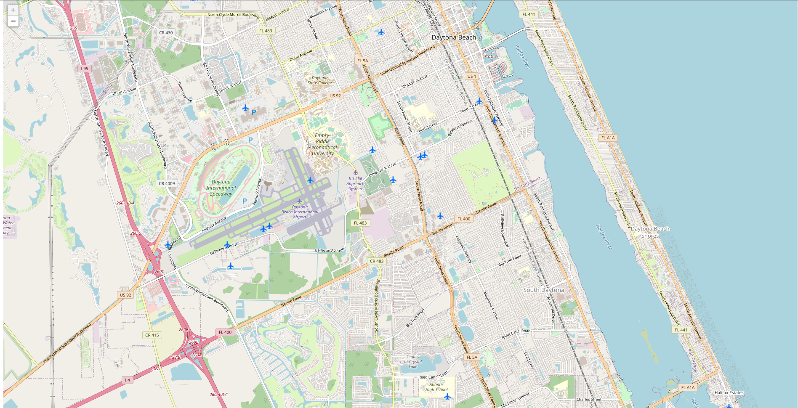
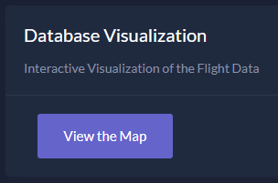
Flask Interactive Map

Slide 36
Resources
[1] https://www.faa.gov/air_traffic/by_the_numbers/
[2] https://nasstatus.faa.gov/ NAS real-time Status
[3] https://www.faa.gov/nextgen/this_is_nextgen/ FAA NextGen
[4] https://www.faa.gov/air_traffic/flight_info/aeronav/atiec/media/Presentations/Day%201%20PM%20009%20Melissa%20Matthews%20SCDS.pdf SWIM Cloud computing
[5] https://opensky-network.org/ OpenSky website
[6]Satria Bagus Panuntun and Setia Pramana, “Development of Automated Flight Data Collection System for Air Transportation Statistics”, IOP Publishing, DOI: 10.1088/1742-6596/1863/1/012020, Available: https://iopscience.iop.org/article/10.1088/1742-6596/1863/1/012020/pdf
[7]Kristian Bortne, “Comparison between RDBMS and NoSQL for Aviation Data”, Norwegian University of Science and Technology (NTNU), AVINOR, June 2019, Available: https://ntnuopen.ntnu.no/ntnu-xmlui/bitstream/handle/11250/2619031/no.ntnu:inspera:2540220.pdf?sequence=1
[8]Changqing Li, Jianhua Gu, “An integration approach of hybrid databases based on SQL in cloud computing environment”, WILEY, DOI: 10.1002/spe.2666, Nov 2018, Available: https://onlinelibrary.wiley.com/doi/pdf/10.1002/spe.2666
[9] M.Hunsi, S.Djanali, H.T.Ciptaningtyas and I.G.N.A Wicaksana, “Improved Information Retrieval Performance on SQL Database Using Data Adapter”, IOP publishing, DOI: 10.1088/1757-899X/306/1/012078, 2018, Available: https://iopscience.iop.org/article/10.1088/1757-899X/306/1/012078/pdf

Slide 37
RESOURCES
[10] Matthias Schäfer, Martin Strohmeier, Vincent Lenders, Ivan Martinovic and Matthias Wilhelm. "Bringing Up OpenSky: A Large-scale ADS-B Sensor Network for Research". In Proceedings of the 13th IEEE/ACM International Symposium on Information Processing in Sensor Networks (IPSN), pages 83-94, April 2014.
[11] ADS-B. ADS-B – Frequently Asked Questions (FAQs). (2022, January 26). Retrieved February 6, 2022, from https://www.faa.gov/nextgen/programs/adsb/faq/#g1
[12] API : https://opensky-network.org

